Slide 1
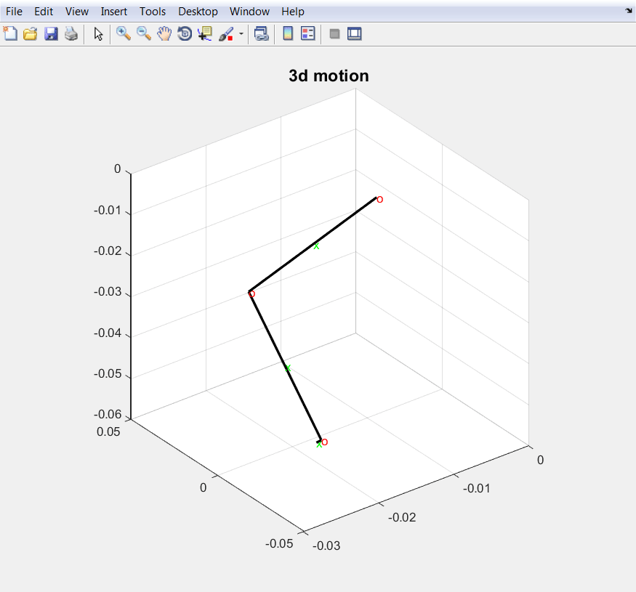
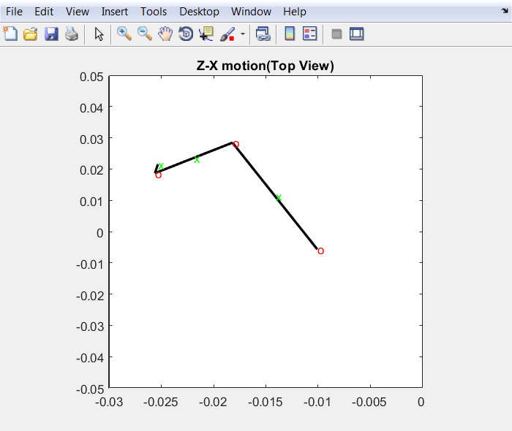
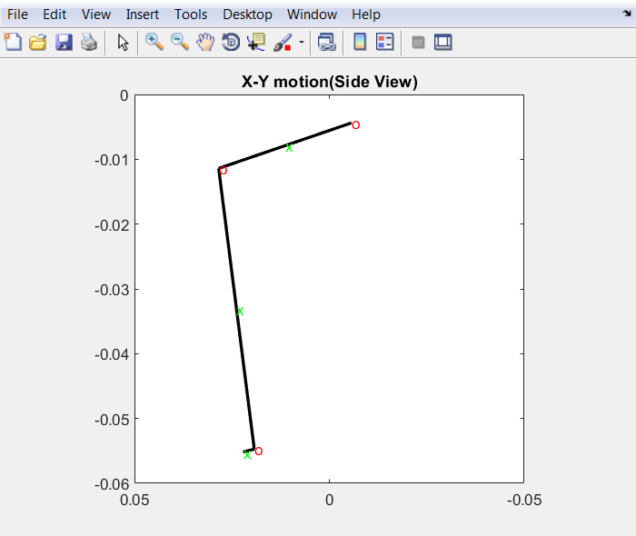
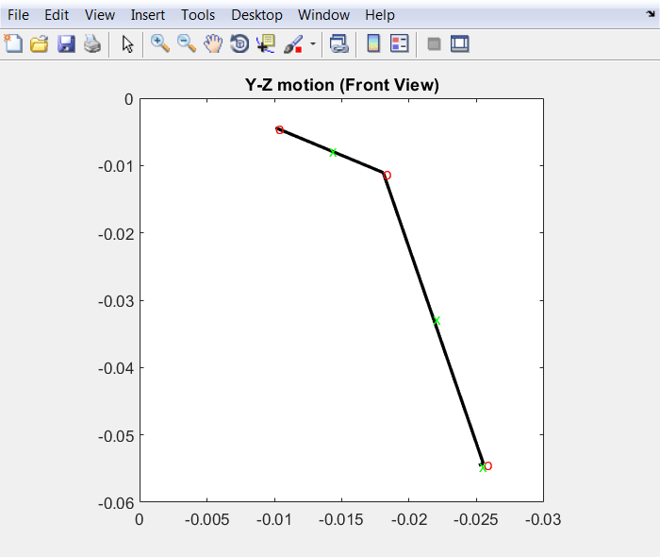
Continue from last time
Modified rotation matrix
Corrected the joint angle rotate coefficient
Now the body parts align with joints
The walking motion looks more realistic than last time

Slide 2
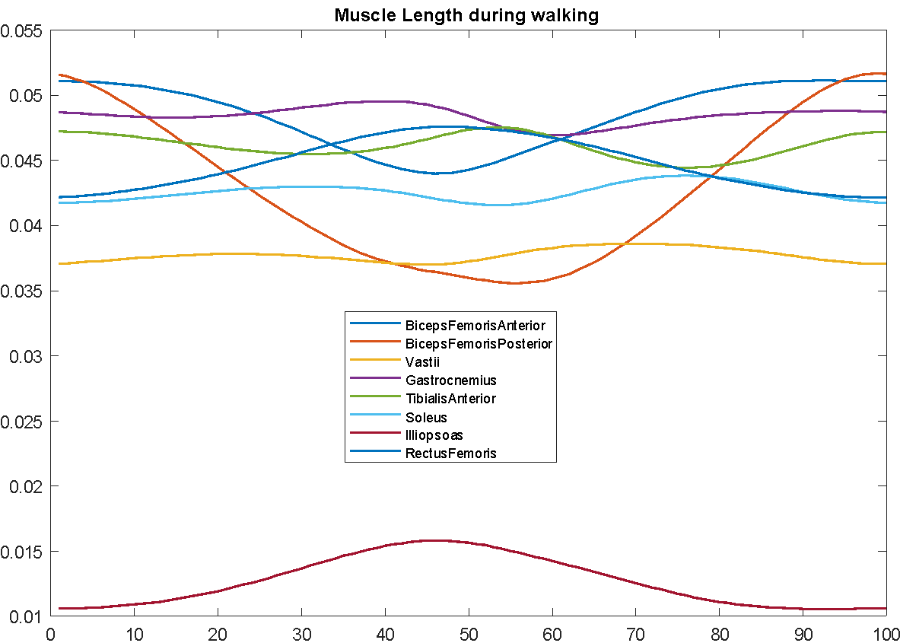
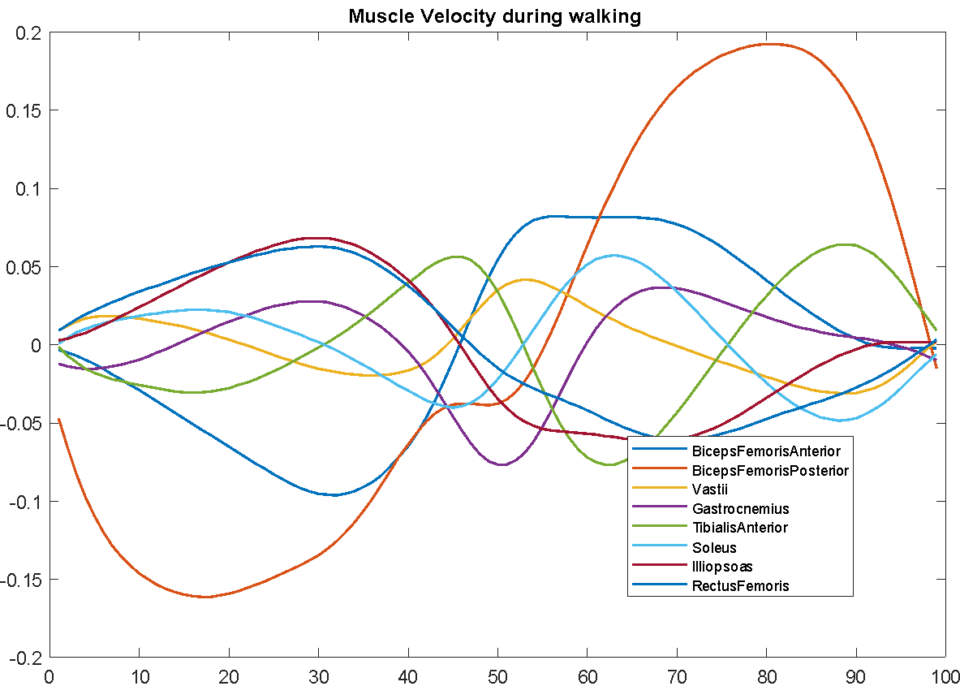
Muscle length and velocity profile during walking
Assort muscle attachment with correct body parts, using the rotation matrix and joint rotate coefficient which we calculate the body and joint motion to get the world position of those attachments.

Slide 3
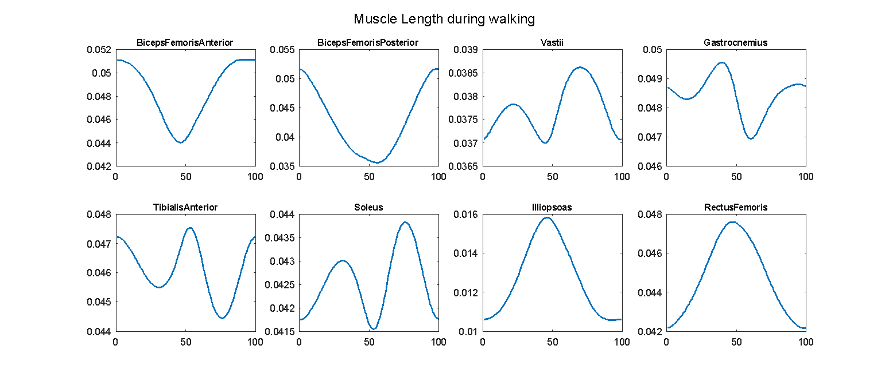
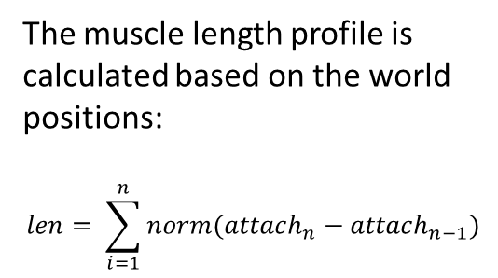
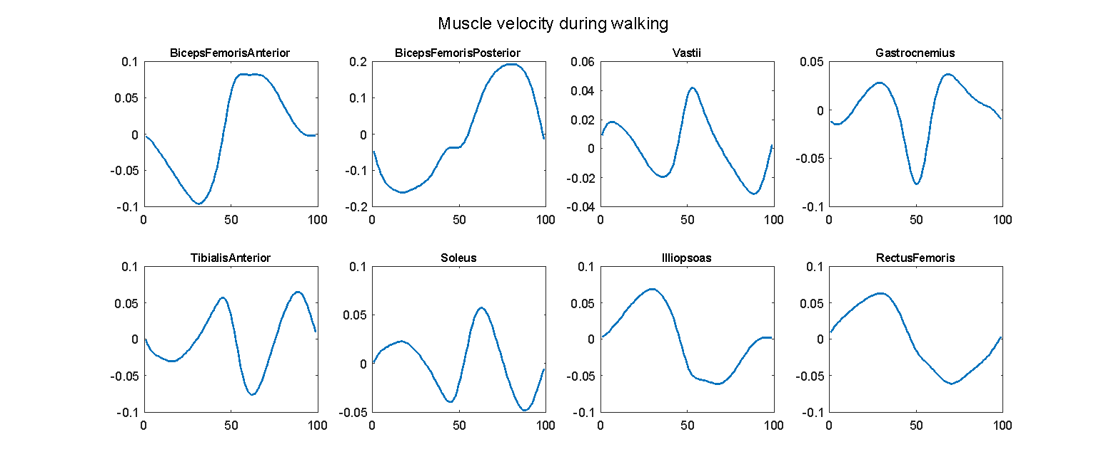
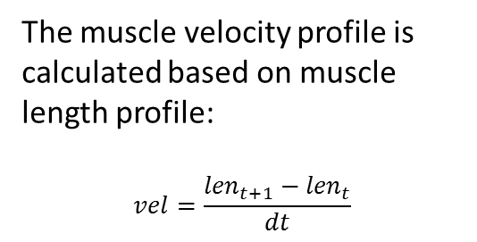

Slide 4
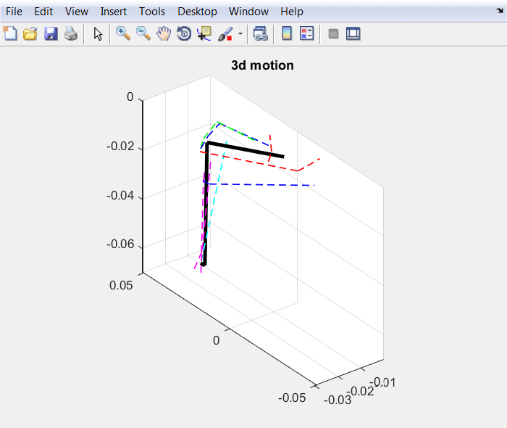
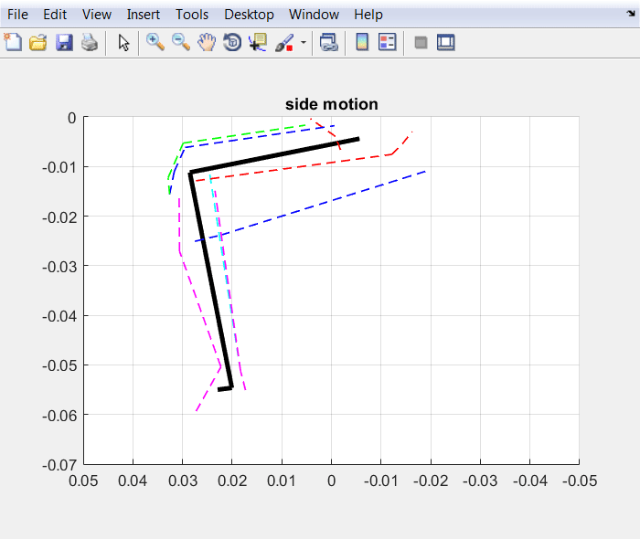
Visualized Muscle motion with walking (3d and Side)
Axis are set to proportional 1:1:1 to simulate the motion more realistic

Slide 5
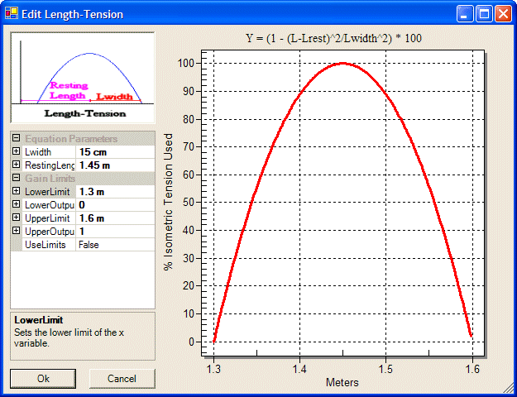
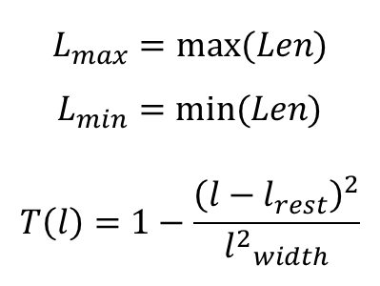
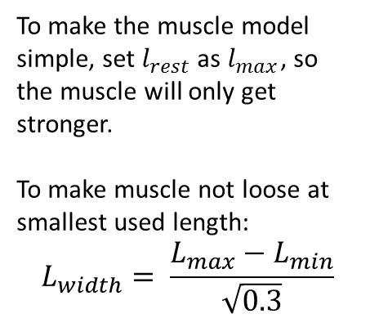
Muscle Parameters

Slide 6
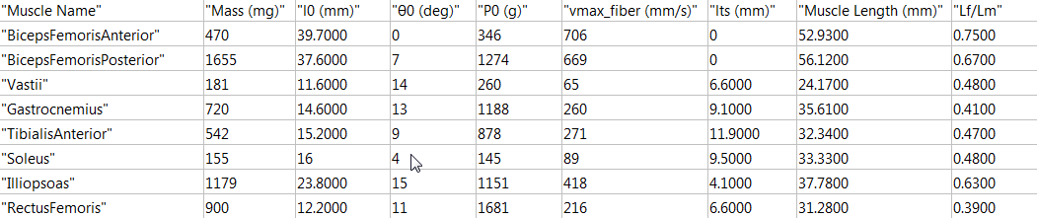
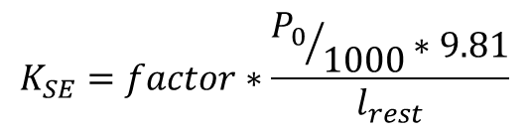
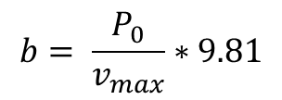
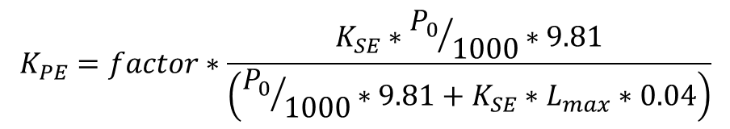
Muscle Parameters
From Johnson 2011 & Charles 2013, I0 is optimal fiber length, Θ0 is pennation angle, P0 is isometric force, vmax is maximum shortening velocity, Its is tendon slack length.

Slide 7
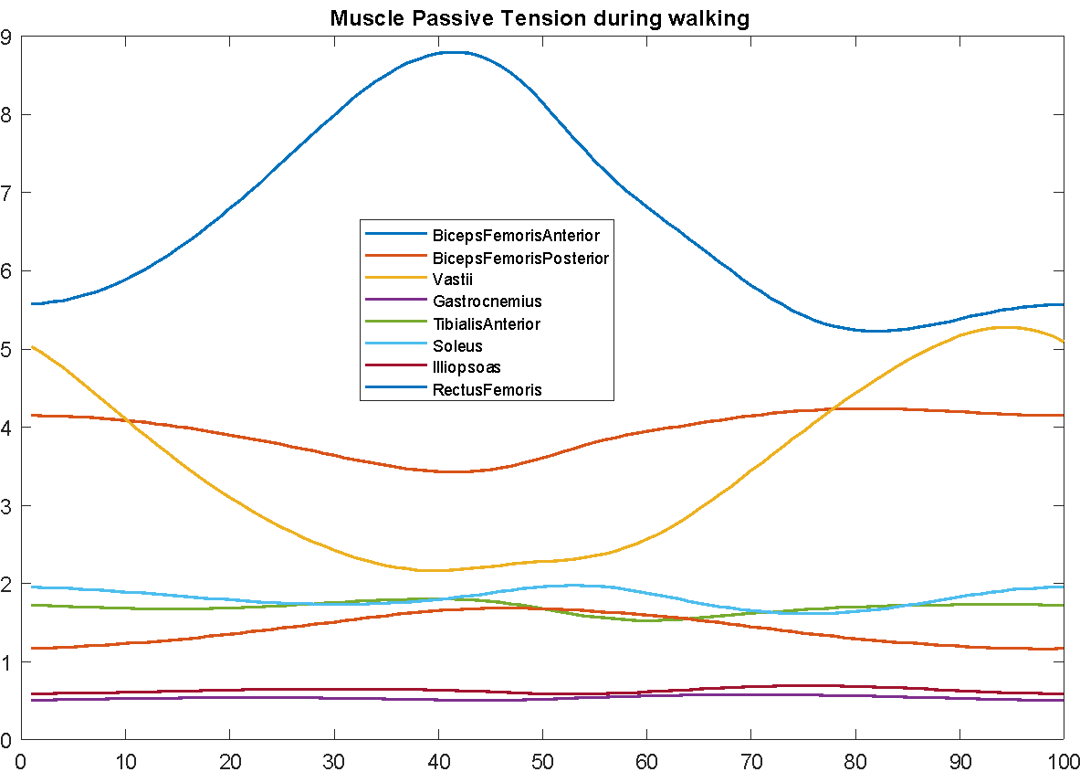
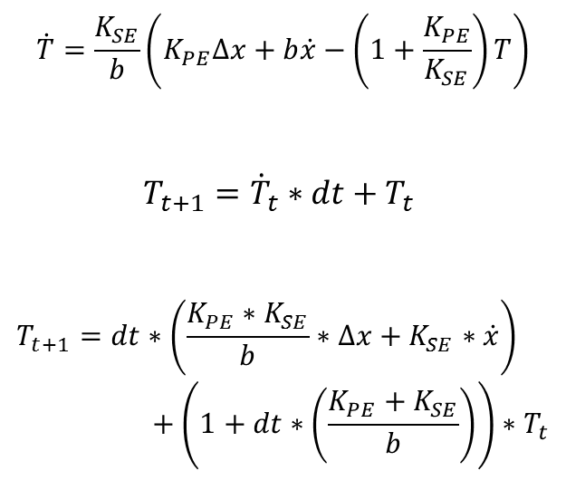
Muscle Passive Tension Profile during walking

Slide 8
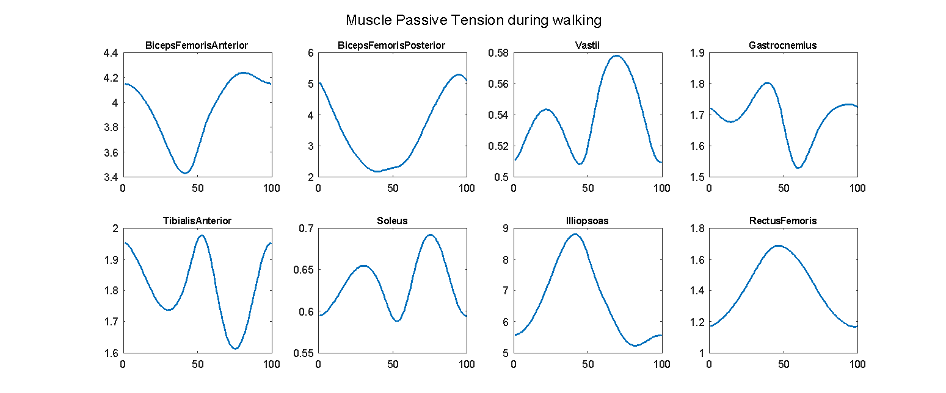
Muscle Length & Velocity vs Muscle Passive Tension

